Slide 1
<Name / Role>
<Date>

Slide 2
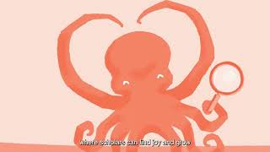

Slide 3
A centre of expertise on collaborations
A space to find support for unusual inter- and transdisciplinary research
A lab to understand and learn about processes of collaboration
A source of leverage on shifts in academic culture and system
A hub for training competences for collaborations across boundaries

Slide 4
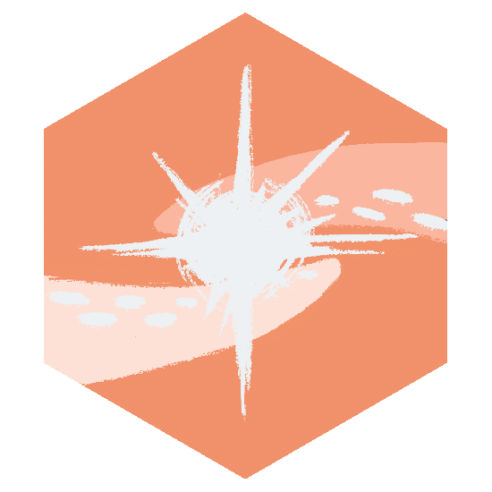
Join CUCo!
Grants
- Spark, €K9 for one year
- Unusual Collaborations, €K50- 140 up to three years
Training and coaching
Training on inter- and transdisciplinary competences
Process coaches for research teams
Expertise and resources
Open-access tools, methods and approaches to facilitate collaborative processes
Notes:
Grants
Spark grant: initial support to build an interdisciplinary team and explore a potential idea. Two times a year, application window: January-February and July-August including 4 half day workshops to train interdisciplinary competences (optionally: share flyer ‘Spark training Internal’)
Unusual Collaborations (50k - 140k): enable outside-the-box inter-and transdisciplinary research. By invitation only, to Spark (>1 year) and UCo ( <3 years) teams, once a year
Training and coaching
Trainers pool: host the two-day Spark training to strengthen early and mid-career academics’ interdisciplinary competences, prepared for a specific context (optionally: share flyer Spark training external)
Process coaches: available to the research teams for guidance on the collaborative process (see example Chronic Pain Team how this process coach was of help in terms of creating the methaphor and to find a common ground -> https://unusualcollaborations.ewuu.nl/2024/10/09/interview-uniting-disciplines-a-journey-towards-understanding-chronic-pain/)
Expertise and resources
Documentary on interdisciplinary collaboration for teaching or promotional goals (free access via Youtube, title 1+1=3 Overcoming barriers in interdisciplinary research). Follows an Unusual Collaborations team, Structures of Strength, in their interdisciplinary collaborative work, showcasing the challenges, barriers and ways to overcome them.
Explore insights on collaborative processes in blogs written by CUCo-affiliated researchers, all accessible via the website + find the online toolbox with methods and approaches including descriptions about aim, theoretical background and use of these methods

Slide 5
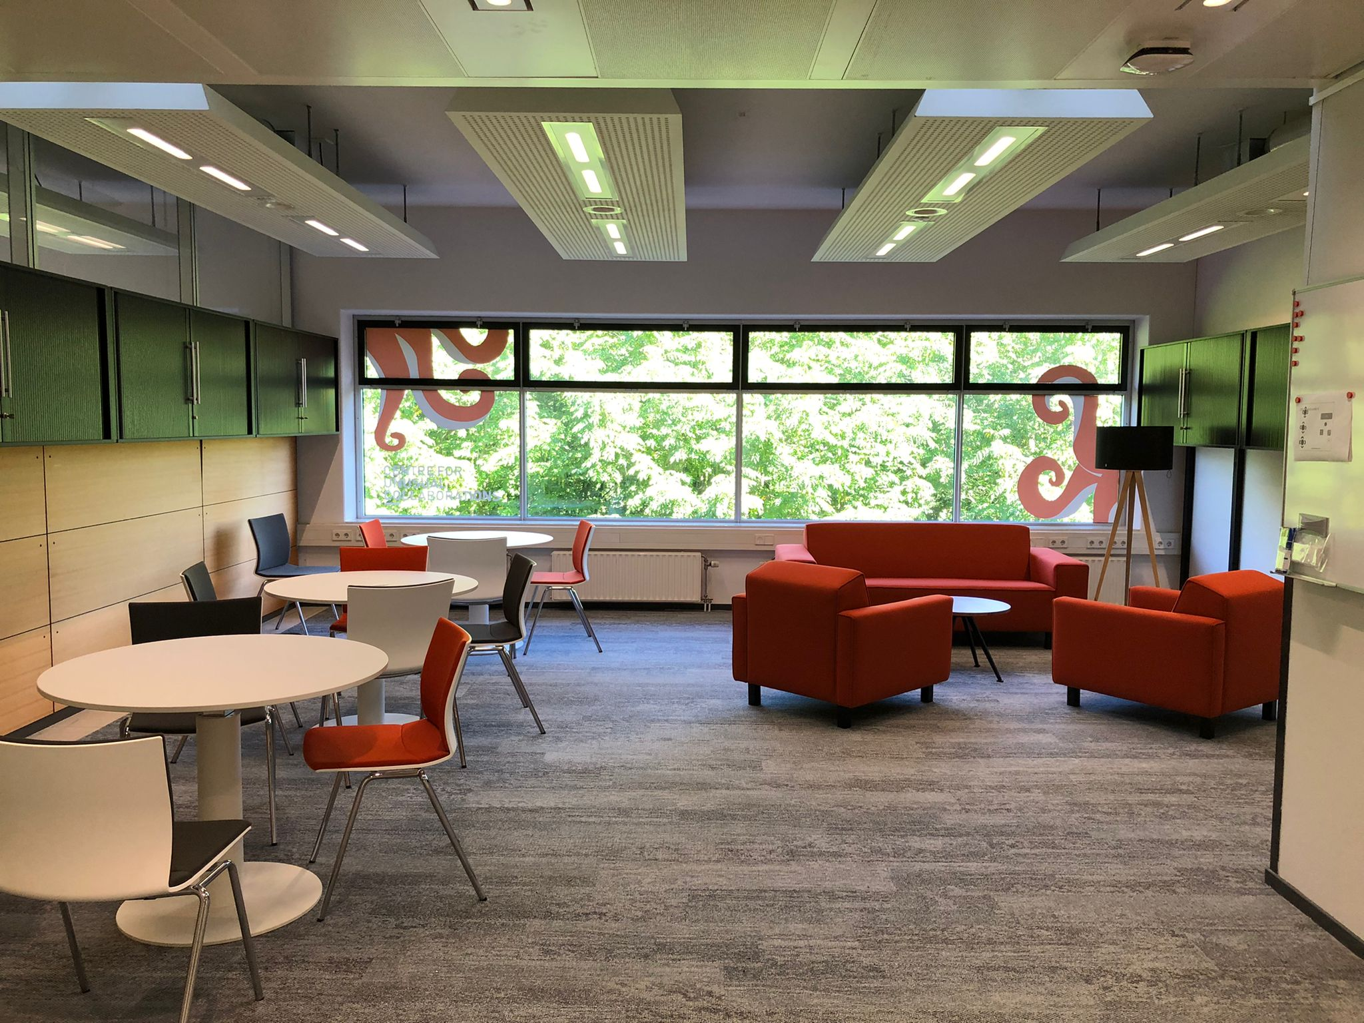
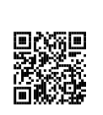
CUCo’s Nests
Utrecht
Vening Meinesz C building
Utrecht Science Park
Wageningen
StartHub, Plus Ultra II building
WUR Campus
Eindhoven
Disruptor Building
Eindhoven Campus
unusualcollaborations.com
cuco@ewuu.nl
Notes:
Essential:
Attitude of humility and deep listening
Get to know each other
Understand each other’s epistemics and language
Build trust
Reflect on the process (50% of effort!)
Dedicated, mission-driven leadership
Use of creative methods
Time

Slide 6
Examples -
Spark teams
Goal: initial support to build an interdisciplinary team and explore a potential idea

Slide 7
Exploring digital health monitoring with a complex systems approach
Aim To reach a common understanding of what complex systems approaches can bring to health research. This is done by applying a complex systems lens to digital health monitoring with smart technology.
Team physics, demography, marketing and sociology
Contact kristina.thompson@wur.nl

Slide 8
Dismantling Disparities
Aim To explore inequalities in academic success and examine whether interdisciplinary collaborations reduce or deepen these disparities. This is done by analyzing success patterns and evaluating effects of cross-disciplinary partnerships on equity.
Team sociology, cultural geography, engineering, plant biology
Contact d.mazrekaj@uu.nl
Notes:
example projects (Sparks & UCo) - 2024

Slide 9
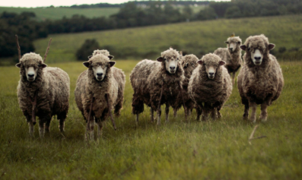
Five-Legged Sheep
Aim To investigate challenges faced by early and mid-career scholars in interdisciplinary and transdisciplinary research. This is done by exploring support strategies like training networks and team-based hiring to enhance their success.
Team soil physics, training for interdisciplinary and interprofessional development, inter- and transdisciplinary collaborations
Contact a.horn@uu.nl
Notes:
example projects (Sparks & UCo) - 2024

Slide 10
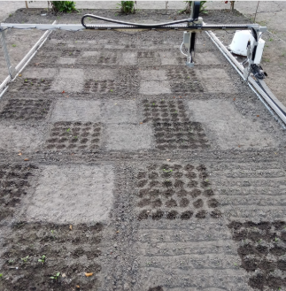
Going Off the Grid
Aim To create innovative, biodiversity-enhancing farm designs. This This is done by using a mathematical framework to rethink food production infrastructure and its integration into the landscape.
Team mathematics, computer science, agro-ecology, design
Contact m.loffler@uu.nl
Notes:
example projects (Sparks & UCo) - 2024

Slide 11
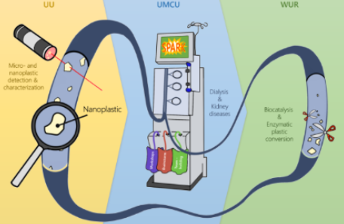
Micro- and nanoplastic formation and detection through dialysis
Aim To study the origins and effects of nanoplastics from dialysis machines (essential for kidney failure patients) and explore using enzymes as biocatalysts to break these particles into harmless substances.
Team environmental science, epidemiology, medical science, biotechnology
Contact l.d.b.mandemaker@uu.nl
Notes:
example projects (Sparks & UCo) - 2024

Slide 12
Multiple Faces of Health
Aim To explore how health is shaped by factors like financial status, religion, and culture. This is done by understanding diverse health goals in an era of advancing health technologies.
Team literature studies, medical science, animal welfare, arts
Contact marc.bracke@wur.nl

Slide 13
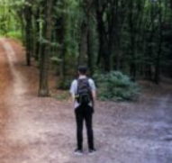
My Choice Matters
Aim To make science accessible and promote a healthier environment for all. This is done by addressing societal challenges by empowering people from lower socioeconomic backgrounds with decision-making skills through co-created, evidence-based communication strategies.
Team biomedical engineering, animal welfare, educational science, geoscience
Contact d.georgiou@uu.nl

Slide 14
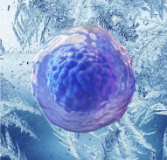
Preservation of Female Reproductive Health
Aim To address female fertility preservation using emerging techniques for storing oocytes, embryos, and ovarian tissue. This project combines expertise to bridge gaps and integrate technical and ethical approaches in both human and animal contexts.
Team molecular biology, ethics, biomedical engineering, science and technology studies, public administration and policy, industrial design
Contact m.villani@uu.nl

Slide 15
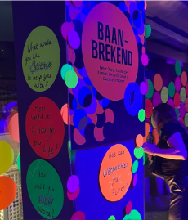
Rethinking Impact*
Aim To rethink impact in academia, challenging its overuse and reliance on metrics. This is done by promoting regenerative practices linking research, education, and public engagement, using unconventional methods like art and nature to uncover overlooked insights.
Team physics, biology, industrial design, political sciences
Contact p.degraaf-4@umcutrecht.nl
* this Spark project is completed. Get more insights here

Slide 16
[UN]BOX
Aim To improve collaboration between practitioners and researchers. This is done by creating a ‘process black box’ prototype, a tool that uses metaphors to help teams design, monitor, and discuss their collaboration processes.
Team transition sciences, industrial design, gamification, technology policies, design, ethics, transdisciplinary research and education, psychology, computer science
Contact j.colenladeiatorrens@uu.nl

Slide 17
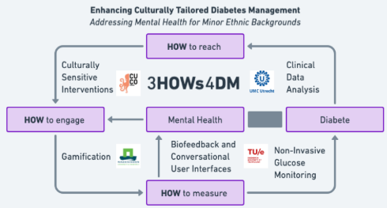
3HOWs4DM
Aim To study the link between type-2 diabetes and mental health.
This is done by using wearable devices for non-invasive glucose monitoring, with a focus on mental health and design user-friendly interfaces for all literacy levels.
Team epidemiology, mechanical engineering, soil physics, computer science
Contact f.ahmadizar@umcutrecht.nl

Slide 18
Examples - Unusual Collaborations
Goal: to take an idea or project further by enabling outside-the-box inter- and transdisciplinary research that is societally relevant and may aim to contribute to societal impact.

Slide 19
All in the Same Boat
Aim To improve water security by creating an open-access framework with indicators for evaluation and enhancement. In collaboration with the Watermuseum and artists, the team focuses on four pillars of water security: availability, accessibility, utilization, and stability.
Team chemistry, ecology, law, modeling, technology
Output watch the annual report 2023 All in the same boat
Contact kevin.matson@wur.nl
Notes:
example projects (Sparks & UCo) - 2024

Slide 20
Better Wave than Worry
Aim To identify common early signals in areas like disease, virus spread, and extreme weather, using over a century of expertise in early signaling. The project creates a Community of Practice for learning, comparing signals, and taking proactive action.
Team ethics, human genetics, plant sciences, veterinary medicine, transition studies, science and technology studies, geo science
Output visit the BWtW platform
Contact t.vrijenhoek@umcutrecht.nl

Slide 21
Plasticity: here, there and everywhere*
Aim To explore plasticity as a concept representing resilience, identity, and time. The aim is to determine whether academia should promote its broader use to encourage interdisciplinary insights.
Team media and culture studies, molecular biology, genetics, philosophy of science, biophysics, chemistry, policy, science and technology
Contact o.basak@umcutrecht.nl
*this UCo project is completed.The team is currently working on a book proposal

Slide 22
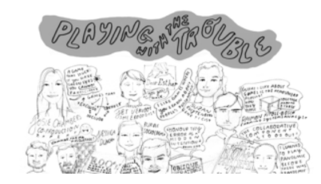
Playing with the Trouble
Aim To tackle navigating diverse worldviews in academia and society by fostering playfulness. This is done by co-designed card decks and activities to support transdisciplinary collaboration, aiming to create a library with 8 physical and 17+ online games.
Team genetics, urban design, soil ecology, epidemiology, rural sociology, organisational design, system thinking
Contact d.j.g.lockton@tue.nl

Slide 23
Smart Food
Aim To develop edible origami systems for controlled drug and nutrient release. This is done by using 3D/4D printing and soft robotics to create ingestible systems.
Team food physics, pediatric immunology, marketing, economics, veterinary medicine
Output watch the Origami project and read the final report
Interview Understanding how society perceives our technology is crucial
Contact mehdi.habibi@wur.nl

Slide 24
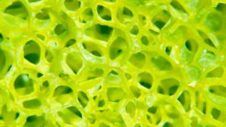
Structures of Strength
Aim To develop porous materials for applications spanning health, energy, food, and environmental science.
Team biomedical sciences, environmental sciences, chemistry, mathematics, computer science, engineering, nanotechnology
Output documentary 1+1=3 Overcoming barriers in interdisciplinary research / SoS platform Power of Porous Materials
Contact a.raoof@uu.nl
Notes:
example projects (Sparks & UCo) - 2024

Slide 25
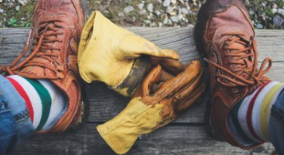
Clean Future: wellbeing in future work
Aim To study stigmatized jobs like sanitation, aiming to address stress, burnout, and health inequalities by improving workplace and social conditions.
Team psychology, sociology, religious studies, cultural geography, educational sciences
Output case studies donkey shelter, hotel housekeeping, and slaughtherhouse
Contact k.c.h.j.smolders@tue.nl

Slide 26
Imagining More-than-Human Communities
Aim To explore equitable relationships between humans and nonhumans. This is done by creating interactive playful formats to inspire ideas for how to imagine and experience more-than-human communities.
Team cultural geography, comparative literature, medical sciences, engineering, media and culture studies, philosophy
Contact k.driscoll@uu.nl

Slide 27
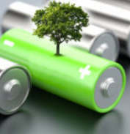
Fair Battery challenge
Aim To develop affordable, reliable, and open-source electrochemical batteries for renewable energy storage, tailored for residential, commercial, and rural health applications.
Team economics, chemical engineering, anthropologist, mechanical engineering,`physics
Output watch the Fair Battery Project
Contact s.faez@uu.nl

Slide 28
Examples of previous Unusual Collaborations Teams
Projects that have been funded till the maximum of 4 years

Slide 29
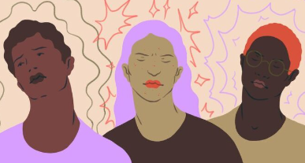
Defeating Chronic Pain - IPOP-NL:
Interdisciplinary Pain Research Platform
Aim To understand chronic pain and improve treatment. Chronic pain is complex and cannot be solved by the medical profession alone.
Team neurobiology, immunology, engineering, linguistics, anaesthesiology, veterinary medicine, molecular biology, psychology
Interview Uniting disciplines - understanding chronic pain
Output IPOP-NL platform
Funds Give for Chronic Pain
Contact h.l.d.m.willemen@umcutrecht.nl

Slide 30
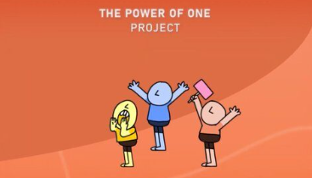
The Power of One
Aim To explore why marginalized people struggle to share their needs with professionals, like researchers and policymakers. This is done by looking at data gaps, challenges in including diverse patients in medical studies, and involving communities in new technologies.
Team immunology, psychology, comparative literature, cultural anthropology, industrial design, law, social sciences
Output annual reports of UCo year 1,2 and 3
Contact d.lakens@tue.nl
Contact team: d.lakens@tue.nl

Slide 31
Extra set of slides

Slide 32
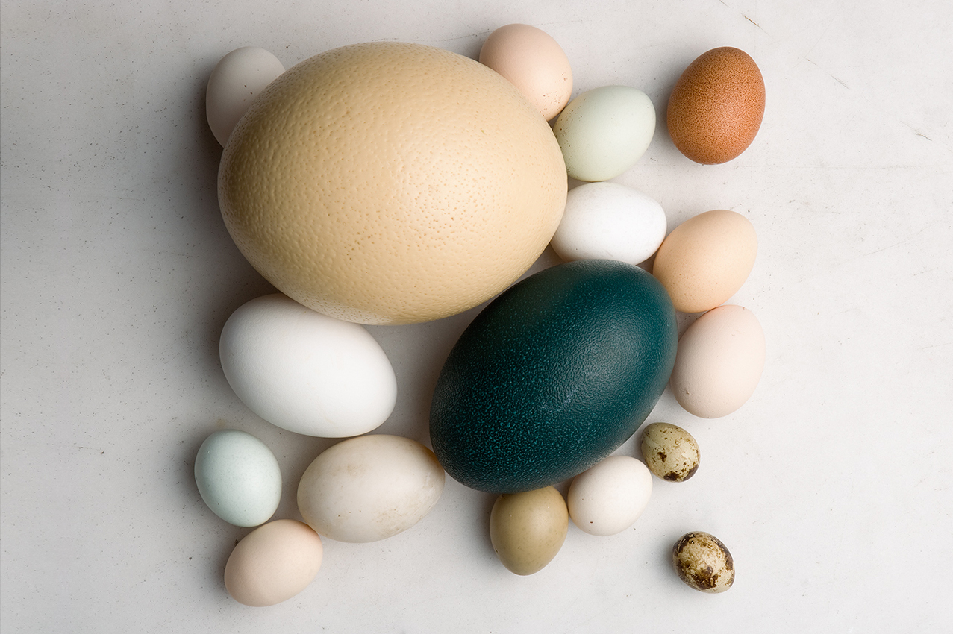
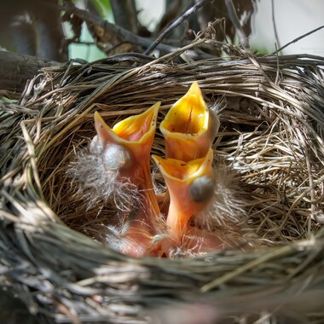
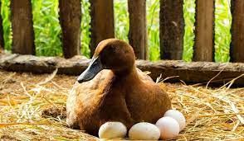
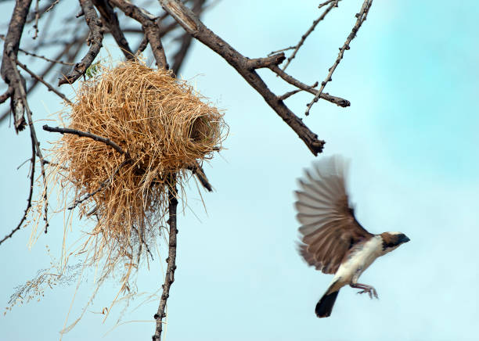
CUCo learning journey
Spark phase 1: workshops
Spark phase 2: a team is composed and a research topic explored, supported by process coaches process coaching
UCo: research teams working on projects, guidance and coaching available
Stand-alone projects, platforms, centres of excellence
Notes:
More info on the Spark training we have developed

Slide 33
Deadline for submitting proposal to enter Phase 2
Apply for UCo, another grant or endterm conversation
Feedback from Board & release of funds
Convene + Disciplinary Grounding
Spark Phase 2:
Team formation and research idea development. Possibly leading to grant proposal. A decision not to continue is also okay.
Support:
Co-learning event with all Spark teams
Process coaching
Tools & methods
Observe + Perspective Taking
Act + Collaboration
Convene
Reflect + Common Ground
Observe
Act
Spark Phase 1:
4 workshops to rain competences and form a team
Reflect
Notes:
Say something about release of funds: at one institute. Tools & techniques: available online, but we are also available for chats and ideas

Slide 34
Funding decision based on lottery
Funding decision based on lottery
Funding decision based on lottery
Other forms of funding
Spark
UCo yr 1
UCo yr 2
UCo yr 3
Phase 1
Phase 2
handshake grant
handshake grant
handshake grant
CUCo Learning Journey
Notes:
Insight into granting scheme CUCo

Slide 35
The unusual trinity
Topic
Team
Process
Notes:
CUCo de-centres from the conventional focus on 'the what' - the theme, the topic, the problem - by giving equal attention to 'the who' and 'the how'. This is called the 'unusual trinity': topic, team and process. The trinity has a central position in CUCo’s funding schemes and in its approaches for collecting, evaluating and providing learnings about the process of collaboration. Essential:
Attitude of humility and deep listening
Get to know each other
Understand each other’s epistemics and language
Build trust
Reflect on the process (50% of effort!)
Dedicated, mission-driven leadership
Use of creative methods
Time

Slide 36
CUCo support
Cross-project working group: one member of each team
kick-off conversation
Gathering cross-project working group
(re-)apply for UCo, or end-term conversation
CUCo Community Day: all Spark and UCo teams
Gathering cross-project working group
mid-term conversation
process coaching by coaches

Slide 37
Funding decision based on lottery
Funding decision based on lottery
Funding decision based on lottery
Other forms of funding
_Better Wave
_Smart Food
_Playing with the Trouble
_All in the Same Boat _Strutures of Strength
_Plasticity
Spark
UCo yr 1
UCo yr 2
UCo yr 3
_Power of One
_Chronic Pain
Phase 1
Phase 2
_Complexity _IMP.A.C.T
_Female reproductive health _Dismantling Disparities
handshake grant
handshake grant
handshake grant
_Unbox
_My Choice Matters
_Fair Battery _More-than-Human Communities
_Clean Future
Notes:
This slide represents teams in 2024

Slide 38
Source: Transdisciplinary Field Guide, UU

Slide 39
Interdisciplinary competences
Source: Matrix with assessment rubrics_202106.pdf (uu.nl)
Learning goals | Skills
Disciplinary grounding | Critical reflection
Perspective taking | Collaboration
Common ground & integration | Communication
 | Adaptability and creativity
Notes:
Spark training based on these skills and learning goals

