Slide 1
Focaccia method

Slide 2
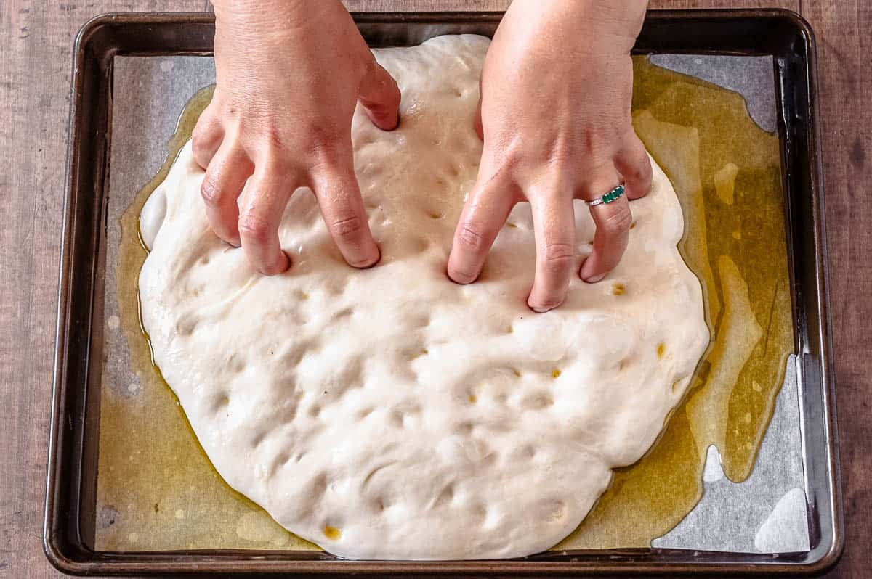
Focaccia method
fold
stretch
poke
(soak, bake)

Slide 3
Fold: Generating questions

Slide 4
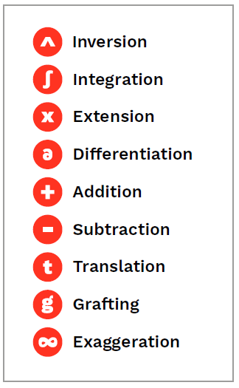
Stretch: Transforming the question(s) - 9 movements
From: The Imaginary Crisis (and how we might quicken social and public imagination)
the-imaginary-crisis-web.pdf (demoshelsinki.fi)

Slide 5
Poke: Questioning the question
What assumptions or beliefs are embedded In the way this question is constructed? What other constructions would give space to examine these assumptions?
How is this question relevant to the real life/work of the people who will be exploring it?
How genuine is this question?—a question to which I/we really don’t know the answer?
What “work” do we want this question to do? What kind of conversation, meanings, and feelings do we imagine this question will evoke?
How unusual is this question? How likely it is to invite fresh thinking/feeling?
What kind of future are you making more real with this question? Does this question leave room for imagination, engagement, creative action, and new possibilities? How could it?

