Slide 1
Interplanetary travel

Slide 2
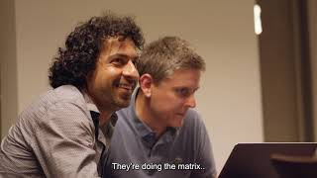
The bigger picture?

Slide 3
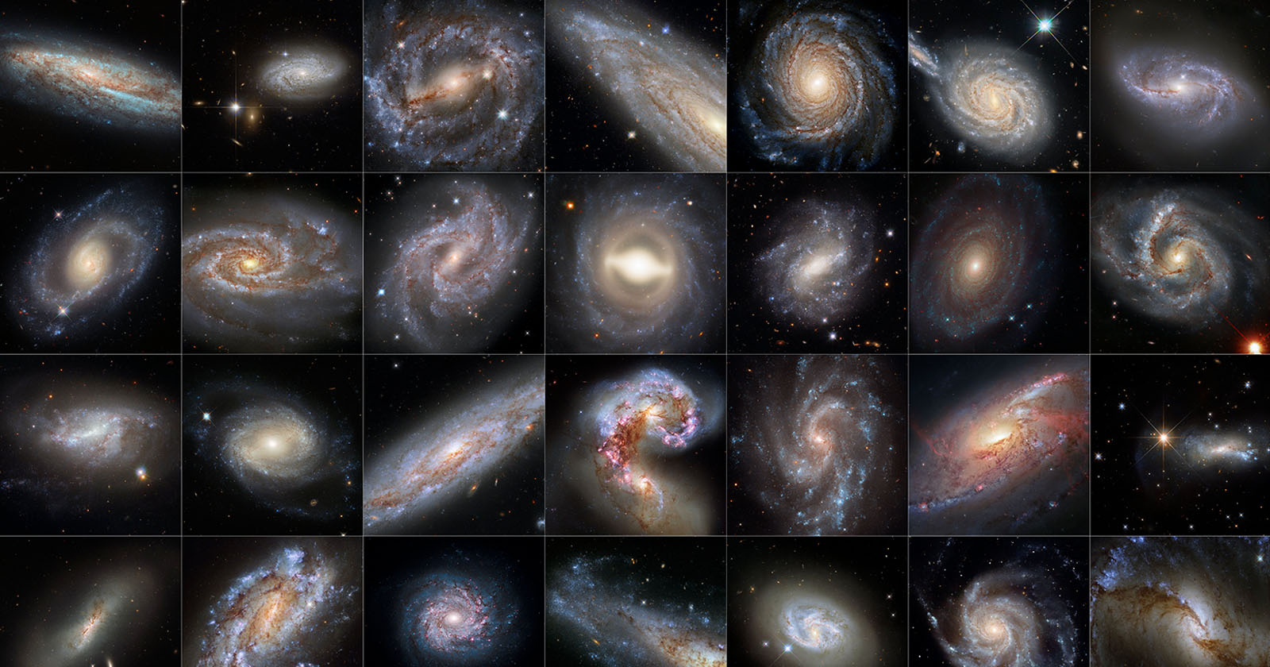
Interdisciplinarity: bridging planets

Slide 4
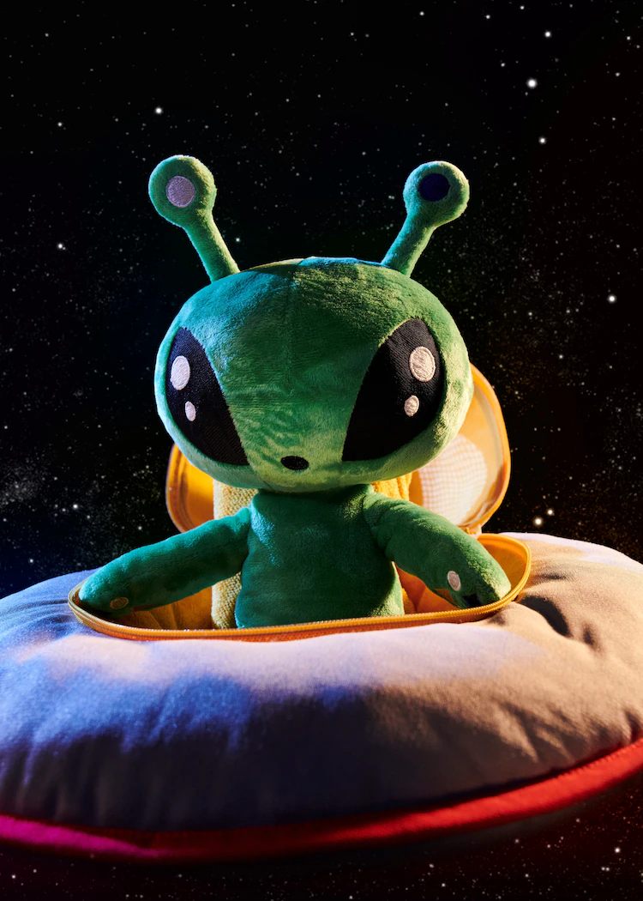
Interplanetary travel: curiosity and wonder

Slide 5
Valuing perspectives in trios: roles
Assign roles (rotate with each round)
1 speaker 🗩
1 listener 👂
1 time-keeper and observer of listening levels 🕑

Slide 6
Valuing perspectives in trios: structure
Sharing perspectives: 3 x 20 minutes per person
follow the 6 steps of the format provided
honour time!
Generative dialogue: 20’
Note:
the format might feel restrictive or unnatural at moments, however we invite you to try it and see what it might be able to do.

Slide 7
Valuing perspectives in trios: steps (20 min p.p)
(4’) Speaker shares topic. Uninterrupted time to speak. Free flow of thoughts and ideas. Stay with silence if it emerges. Listen in service of the other.
Prompts:
What’s the topic?
Why do you care about it? What excites you? What doesn’t? What emotions do you have when working on it?
Why is it relevant and for whom?
(6’) Clarifying/deepening questions by the listeners. As listeners, stick to asking questions, refrain from responding, giving feedback, suggestions, ideas etc.
(1’) Stillness
(3’) Mirroring by listeners in a few sentences, starting with I saw…. , I heard…Reflect back what you’ve heard in your words to speaker. You can also mirror with a gesture, a metaphor (card) or image if that comes up
(4’) Brief reflection on the mirroring by speaker & closing remarks
(2’) Individual journaling
Swap roles twice -

Slide 8
Generative dialogue in trios (20 min)
What are the commonalities and differences you notice?
What did the others allow you to see that you didn’t see before?
What do you realise about the limitations, assumptions and biases of your own (disciplinary) perspective?

Slide 9
Interplanetary harvest
Journaling/drawing (5 m)
Prompt
You’ve visited two different planets and you’re reporting back to your home planet about two different planets you visited: ‘Here’s something similar/different from what we do, and I appreciate it for xx reasons’.
Share: take the alien hat & share what you’ve journaled/drawn about (1 m p.p.)

